Slide 1
WORKING WITH DynamoDB IN AWS
Field Project Presentation
SUBMITTED BY-RADHESH APRE
Under the Guidance of- Prof. Dhiraj Kharade & prof. Shradhha Maam

Slide 2
Introduction & Overview
Uploading DynamoDB JSON File to Amazon S3
Importing Data from S3 into DynamoDB Table
Verifying Imported Records in DynamoDB
Executing Queries using PartiQL in DynamoDB
Creating and Verifying Global Table Replica

Slide 3
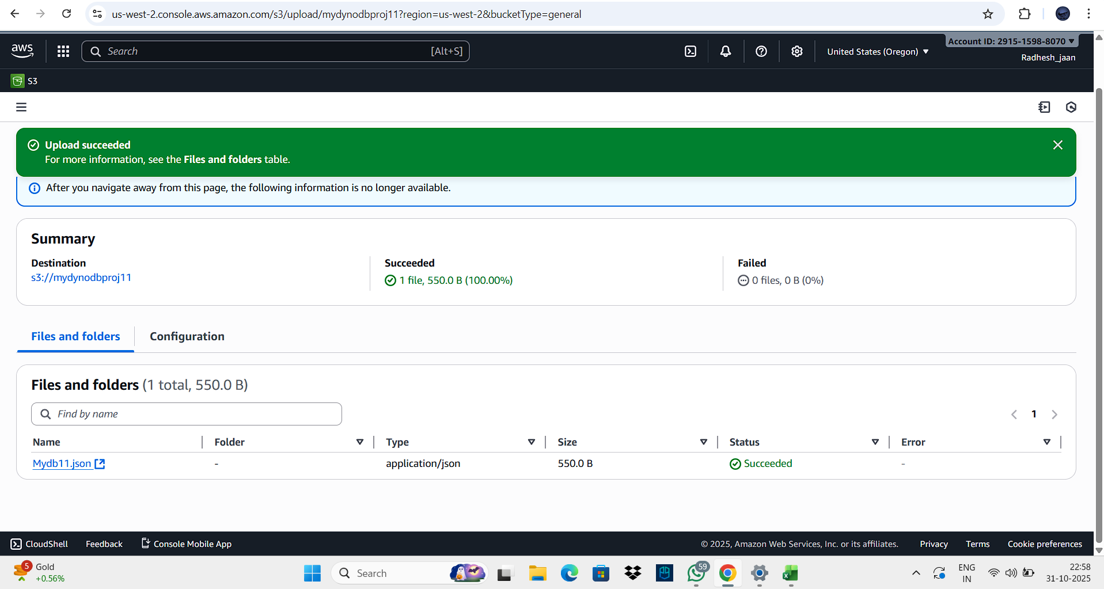
Step 1: Uploading DynamoDB JSON File to Amazon S3
This screenshot shows the Amazon S3 console where the Mydb.json file was successfully uploaded. The file contains structured DynamoDB data ready for import.
-Advantage: S3 ensures durable storage and acts as a bridge between local data and cloud databases.
-Real-world Use: Commonly used for transferring and storing datasets across AWS services

Slide 4
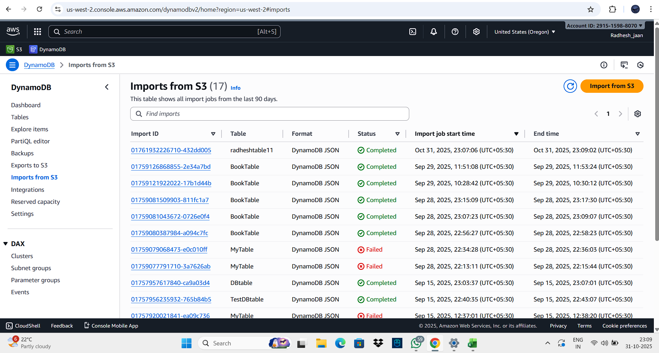
Step 2: Importing Data from S3 into DynamoDB Table
Here, the DynamoDB console’s 'Import from S3' setup page is shown. The uploaded file from S3 is selected, and the table schema is configured with UserId as the Partition Key.
-Advantage: Eliminates manual data entry, offering an automated import process.
-Real-world Use: Helps businesses move bulk datasets quickly into DynamoDB without coding.

Slide 5
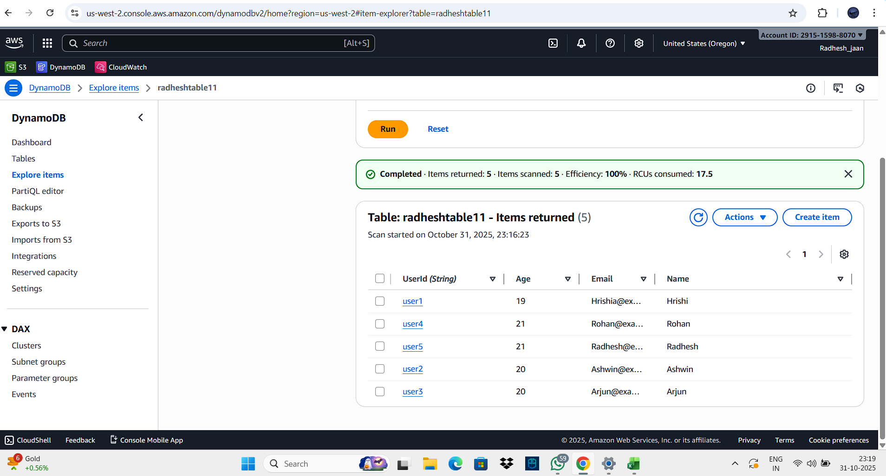
Step 3: Verifying Imported Records in DynamoDB
This screen displays the 'Explore Table Items' view inside DynamoDB after import. All 5 records are visible, confirming successful import and schema mapping.
-Advantage: Provides a simple UI for verifying database content directly in the AWS Console.
-Real-world Use: Used by database administrators for post-import validation and quick checks. Step 4: Executing Queries using PartiQL in DynamoD

Slide 6
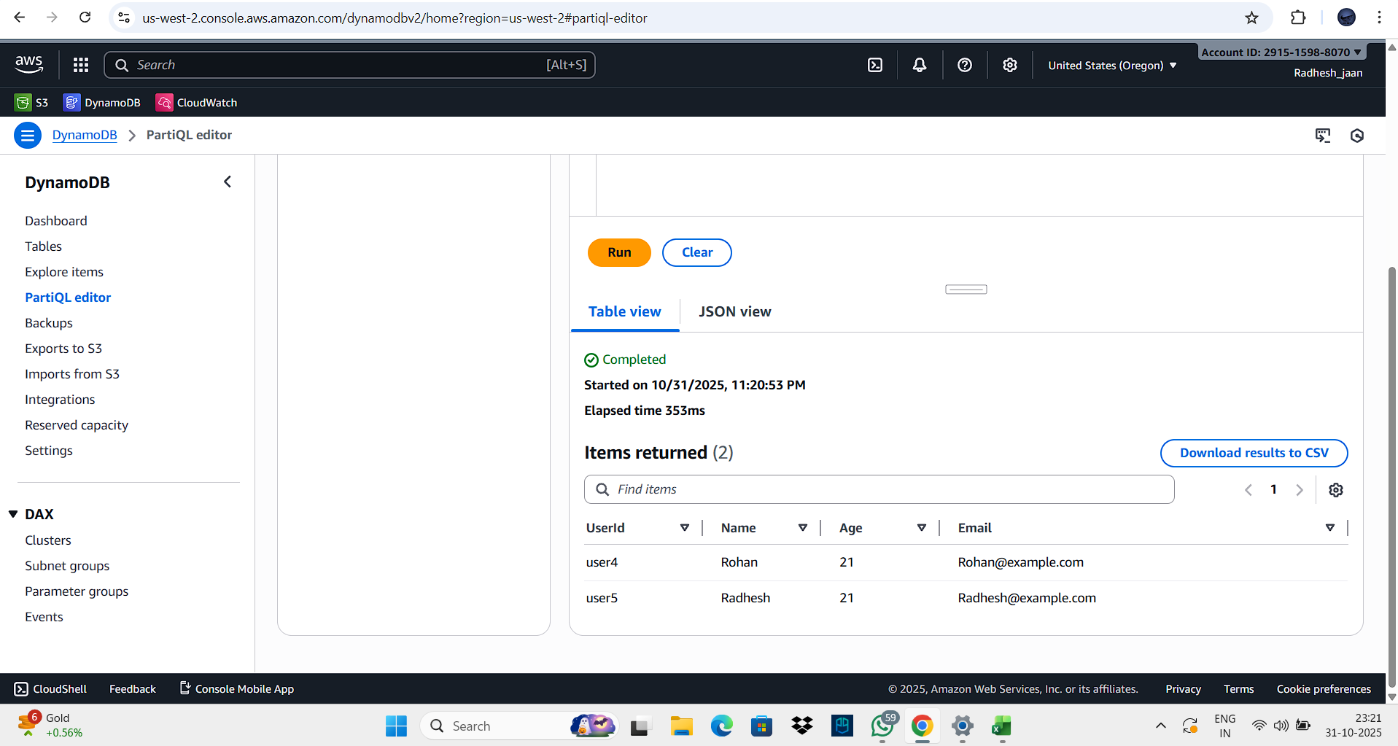
Step 4: Executing Queries using PartiQL in DynamoDB
The PartiQL editor in DynamoDB allows SQL-like querying on NoSQL tables. The screenshot shows a SELECT query filtering users based on Age = 21
-Advantage: Makes data retrieval intuitive and supports conditional filtering.
-Real-world Use: Enables developers and analysts to run ad-hoc queries on live production data

Slide 7
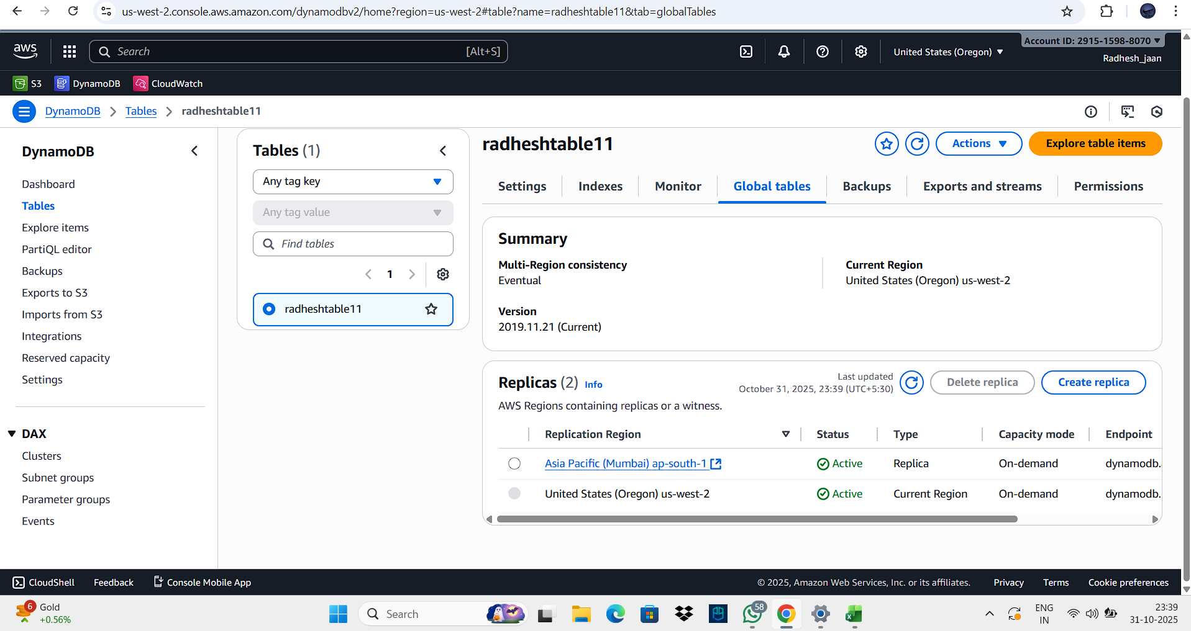
Step 5: Creating and Verifying Global Table Replica
This image shows the Global Tables configuration where replication between Oregon and Mumbai regions is active. Both regions display 'Active' status, indicating successful multi-region replication.
-Advantage: Ensures high availability and real-time synchronization across continents.
-Real-world Use: Vital for global applications like e-commerce or social platforms needing fast data access

Slide 8
THANKYOU

